Slide 1

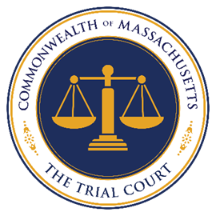
COURT SERVICES AND LAW LIBRARIES DEPARTMENT
Sheriece M. Perry, Esq.
Director

Slide 2
Supreme Judicial Court
“SJC”
Appeals Court
Office of the Jury Commissioner
Trial Court
Massachusetts Probation Service

Slide 3
Executive Office of the Trial Court
Court Departments
BOSTON MUNICIPAL COURT
LAND COURT
DISTRICT COURT
PROBATE AND FAMILY COURT
HOUSING COURT
SUPERIOR COURT
JUVENILE COURT
OFFICE OF COURT MANAGEMENT

Slide 4
OFFICE OF COURT MANAGEMENT
JISD (IT)
Research and Planning (DRAP)
Human Resources
CourtEducation
Legal Department
Office of Workplace Rights and Compliance
Facilities Management and Capital Planning
Fiscal
Security
Office of Access, Diversity, and Fairness

Slide 5
Office of Diversity, Equity and Inclusion
Office of Access, Diversity, and Fairness
Office of Alternative and Online Dispute Resolution
Office of Language Access
Office of Justice Initiatives and the User Experience
(Formerly A2J)
Court Services and Law Libraries Department
Court Records & Transcripts
Court Service Centers
(CSCs)
Law Libraries

