Slide 1

Office of Access to Justice and Court User Experience
Vision
The A2J Office acts as a court-wide information resource for A2J-related needs. It works in collaboration with Trial Court departments and external stakeholders on programs and initiatives designed to enhance access to justice for court users.

Slide 2
Office of Access to Justice and Court User Experience
Strengthening the Court User Experience
Amplifying Resources
Enhancing Accessibility
Improving Forms and Self-Help

Slide 3
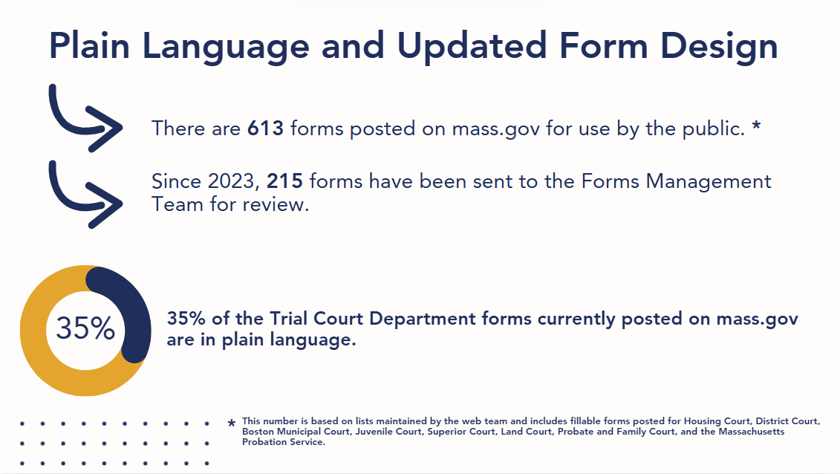
Forms and Self-Help

