Slide 1



Quinten Steenhuis, Co-director
Web: suffolklitlab.org
LinkedIn: company/suffolk-lit-lab/
Notes:
https://recorder.google.com/893ba917-3b1f-48bd-9c6a-c06e9a06fc2c

Slide 2
Students in the lab…
Do legal research
Learn a lot about design and user experience
Meet with court and legal aid staff
Build guided interviews (100% predictable expert systems)
Incorporate AI where appropriate
Plan and test their work

Slide 3
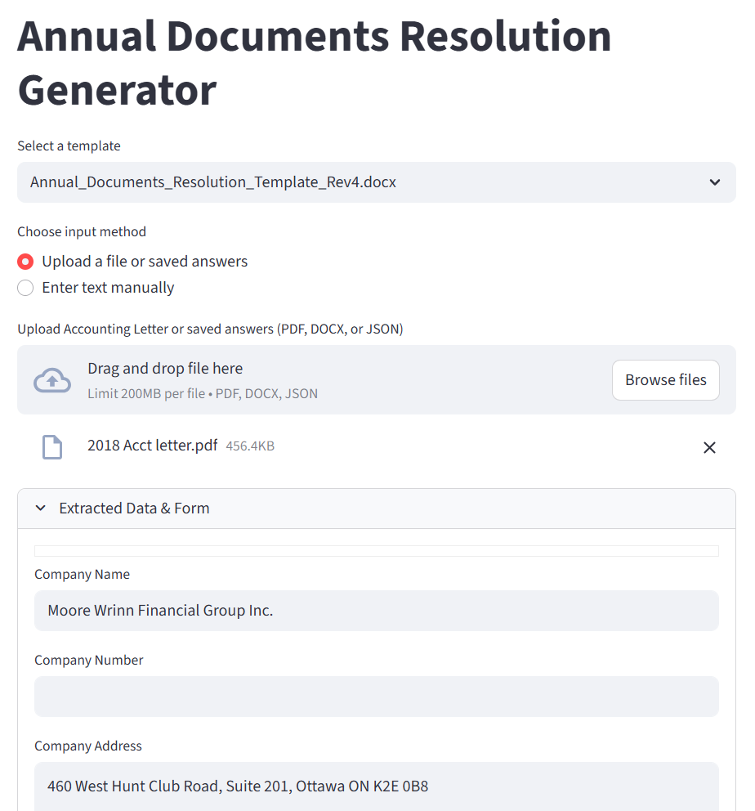
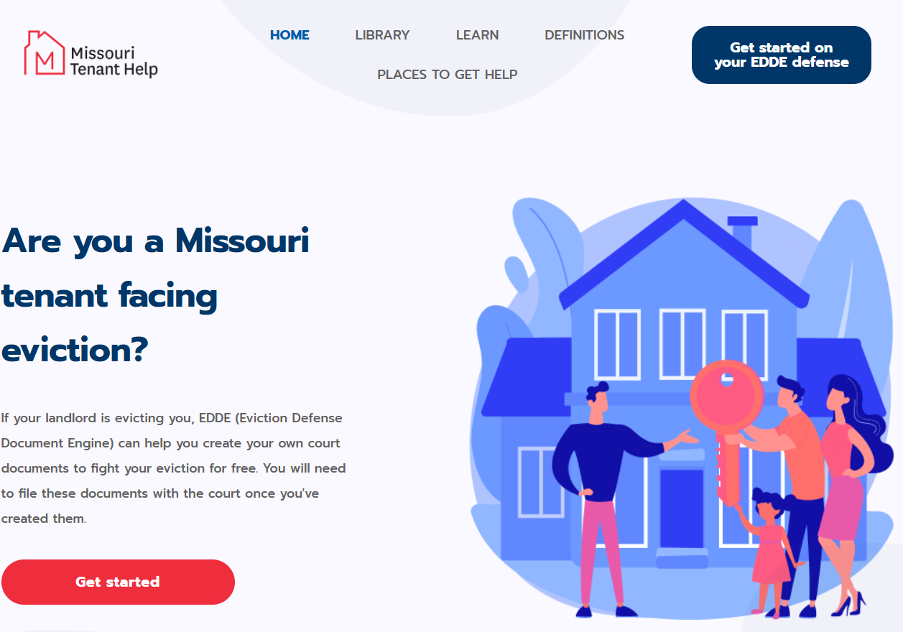
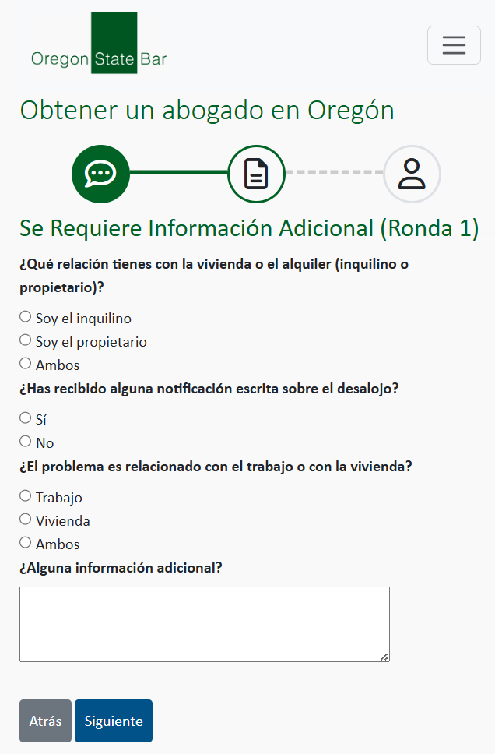
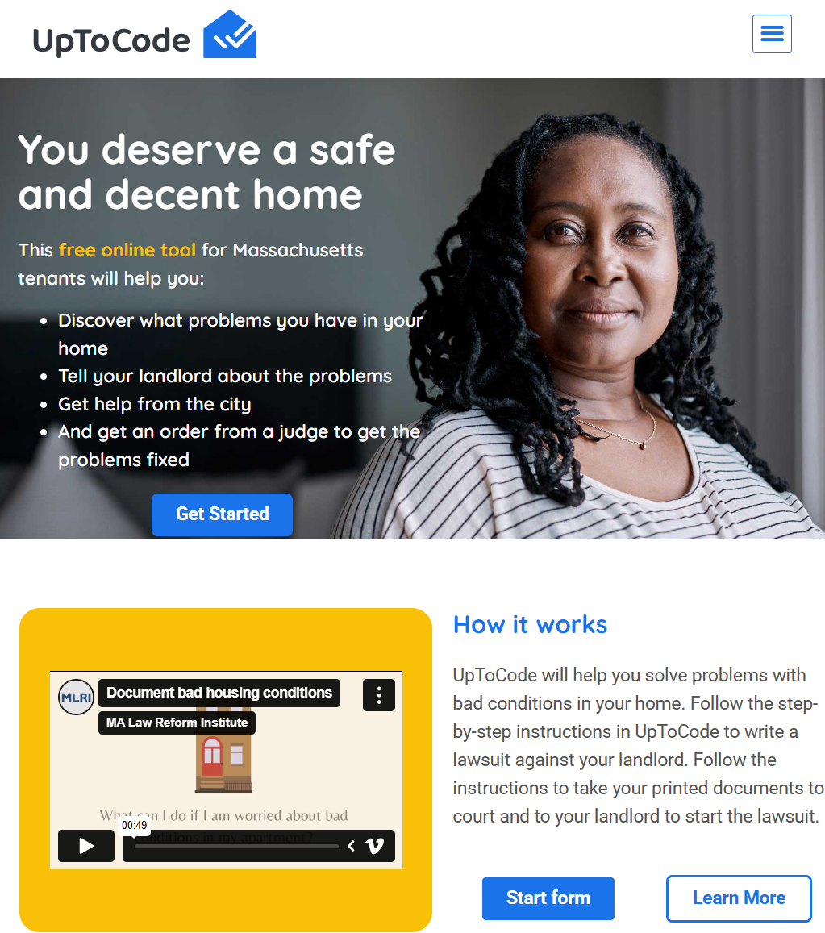
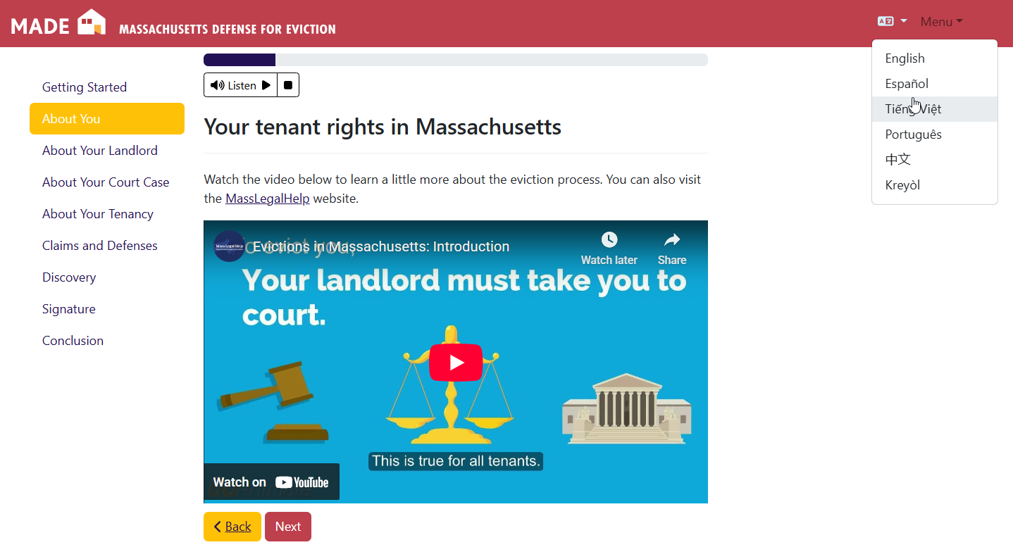

Slide 4
